Slide 1


Automated Web Scraping
Introduction | Website Exploration | Data Scraping | Data Analysis | Summary

Slide 2





OUTLINE
Introduction
Data Scraping
Summary
Website Exploration
Data Analysis

Slide 3

Introduction
About the project:
To build a web scraper for Flickr website.
To collect photographs and the key elements behind such as:
Topics
Equipment used
Camera settings
Geographic locations
To analyze and visualize the data using Tableau.
Objective:
To give the intuition of which kinds of equipment are applicable for given topics.

Slide 4





Project Workflow
Cameras
& Lenses
Geographical Distribution
Data Scraping
Summary
Website Exploration
Data Analysis
Tags
Photo IDs
EXIFs
Geolocations

Slide 5
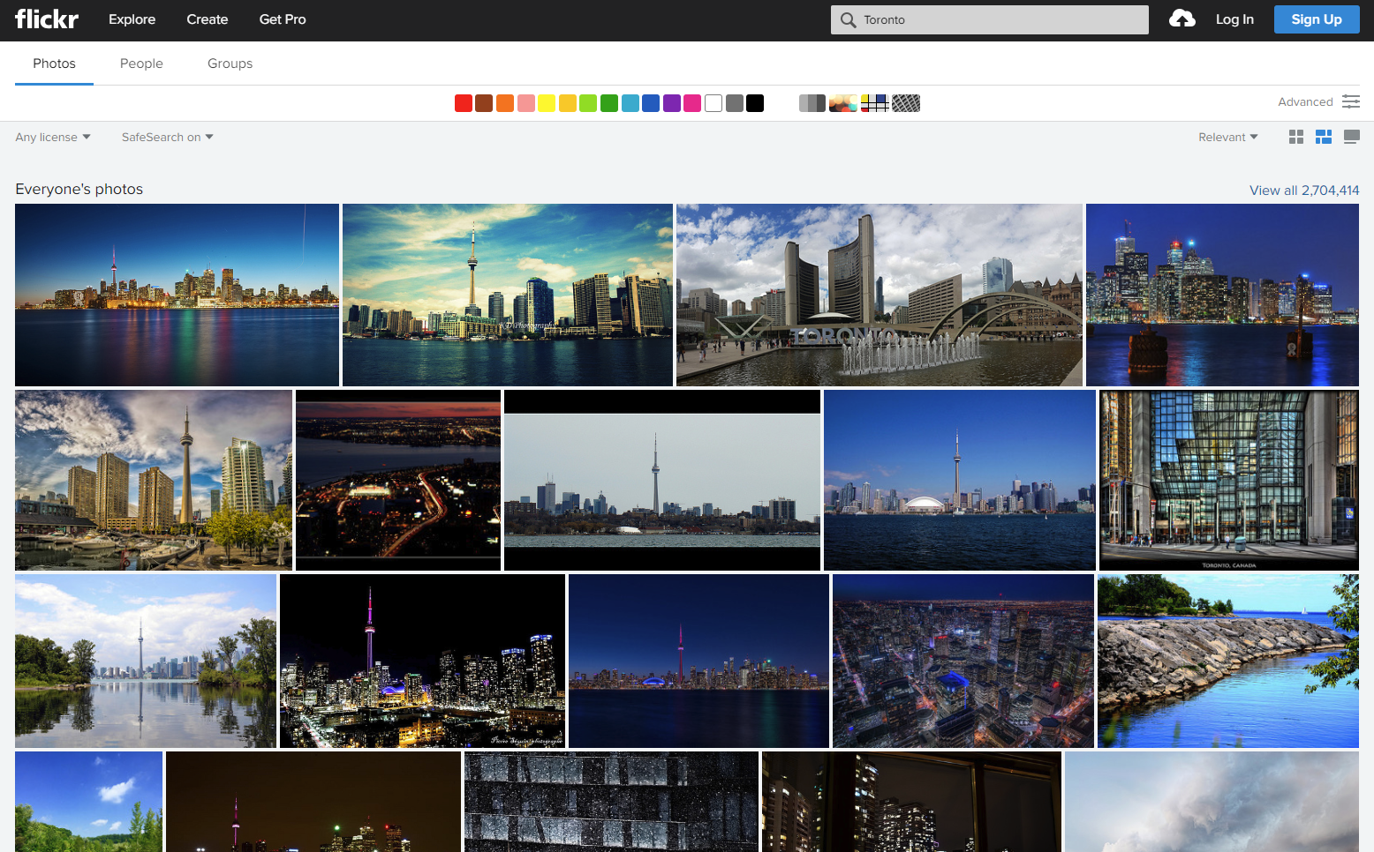
Website Exploration

Slide 6
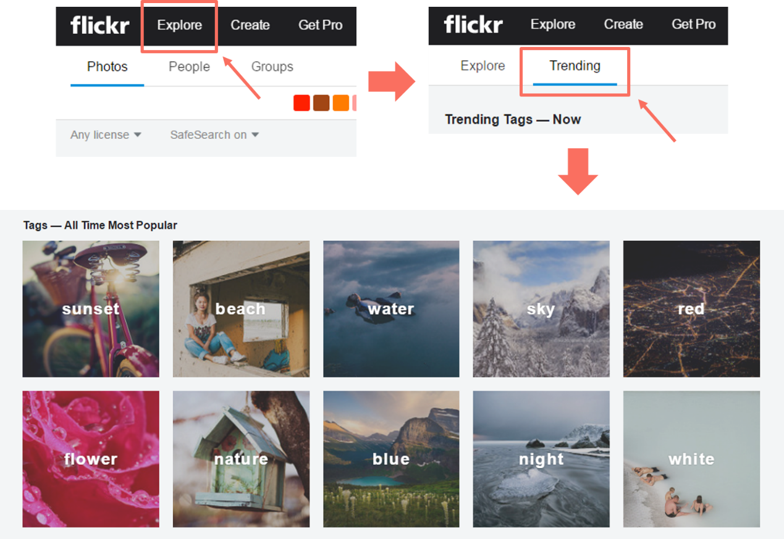
Website Exploration
The hottest tags:

Slide 7
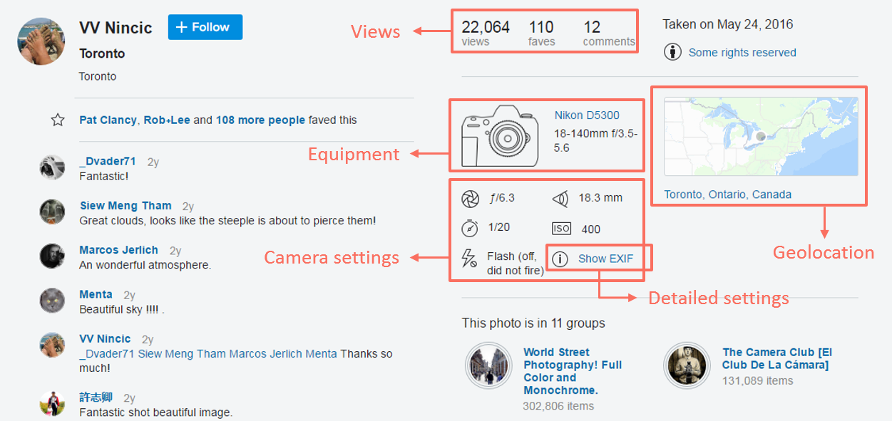
Website Exploration
Picture details (EXIFs):

Slide 8




Data Scraping

Slide 9
Scraping Process
Tags
Flick API
EXIFs
Local
Database
BeautifulSoup
Flick API
Photo IDs
Geolocations

Slide 10

Data Analysis
Cameras
& Lenses
Data Analysis
Geographical Distribution

Slide 11
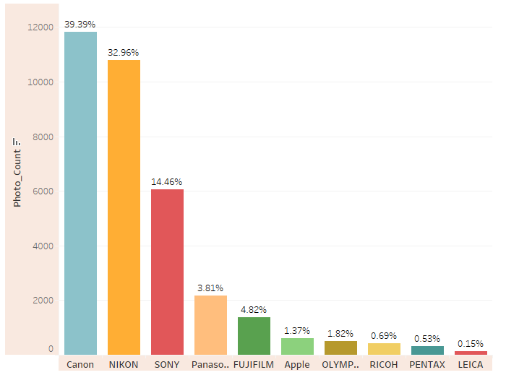
Data Analysis
Brand ranking
CANON, NIKON and SONY are the top three brands used by Flickr users.

Slide 12
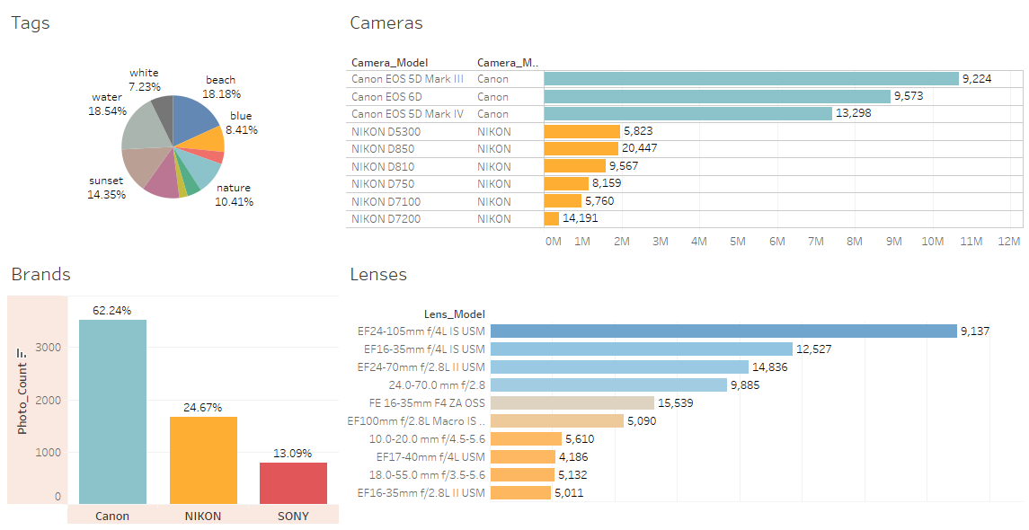
Data Analysis
Cameras & Lenses:

Slide 13
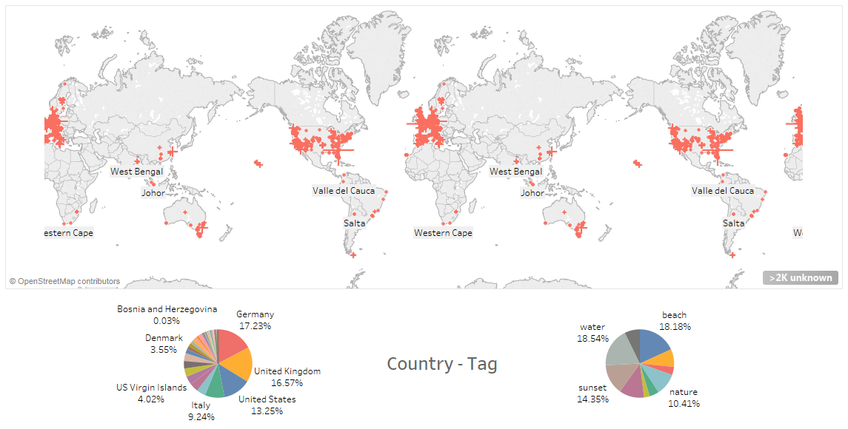
Data Analysis
Geographical distribution:

Slide 14
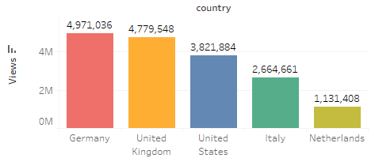
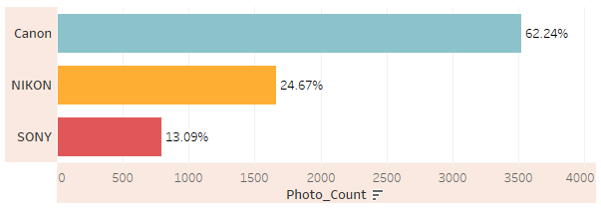
Summary
Western Countries seem like good places to take good pictures.
Top three brands on Flickr are CANON, NIKON, and SONY.

Slide 15
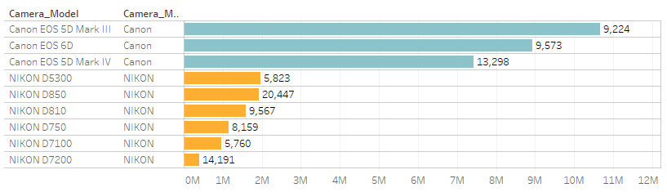
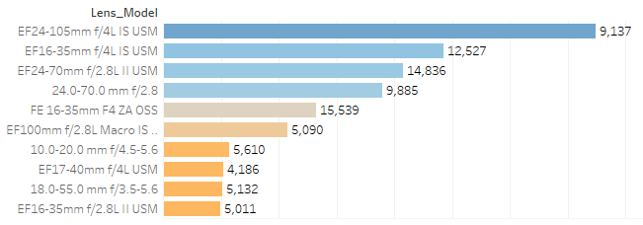
Summary
Top three camera models are all CANON’s products which are a lot more popular than NIKON’s cameras.
The most commonly used lenses are mostly from CANON.

Slide 16

Thank you

